Slide 1
ECE 60658 : Anomalous Hall Effect
Ho Jun Lee (David)
First year Electrical Engineering as MS

Slide 2
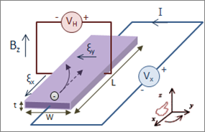
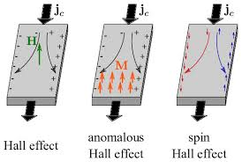
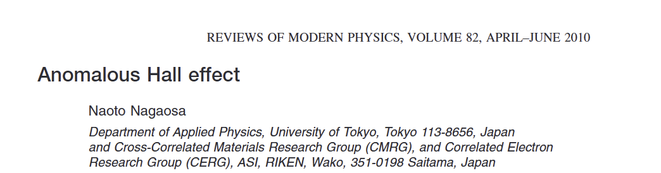
Historical Background
1879 Ordinary Hall Effect
Edwin Hall discovers transverse voltage in non-magnetic conductors under magnetic field B
1881 Anomalous Hall Effect
Hall observes the effect is ~10x larger in ferromagnetic iron without needing B
1954 Luttinger & Karplus
First intrinsic mechanism proposed – band structure origin via spin-orbit coupling
2010 Nagaosa et al. (RMP)
Landmark review unifying all mechanism through Berry curvature framework

Slide 3
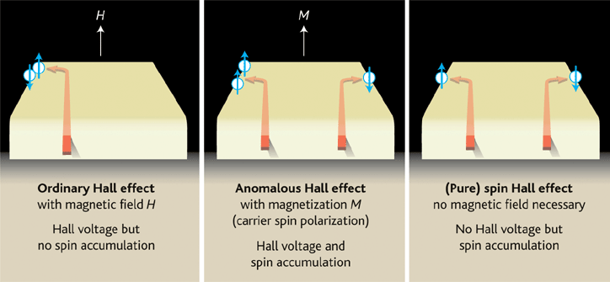
Ordinary vs Anomalous Hall Effect
Ordinary Hall Effect (OHE)
Anomalous Hall Effect (AHE)
Origin | Lorentz force on charge carries
Requires | External magnetic field B
Hall resistivity | 𝜌_{xy} = R_{o}B
Material | Any conductor
Mechanism | Classical – single carrier deflection
Origin | Spin-orbit coupling + broken time-reversal
Requires | Magnetic order (no external B needed)
Hall resistivity | 𝜌_{xy} = R_{o}B + R_{s}M
Material | Ferromagnets & topological materials
Mechanism | Quantum – Berry curvature & scattering
General Hall Resistivity : 𝜌_{xy} = R_{o}B + R_{s}M where R_{s} = Anomalous Hall coefficient

Slide 4

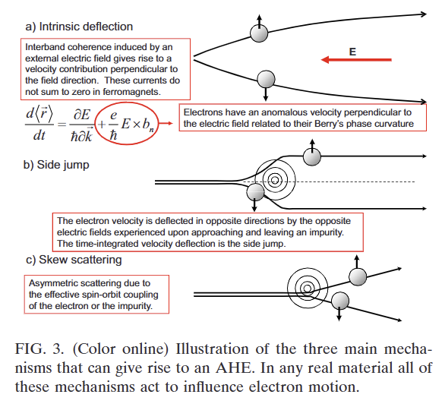
Three Mechanism of AHE
Intrinsic
Skew Scattering
Side Jump
O_{xy}^{sk} = o_{xx} (Linear)
O_{xy}^{sj} = o_{xx}⁰(Independent)
Origin : Band structure / Berry curvature
Regime : Moderate conductivity
Origin : Asymmetric impurity scattering
Regime : High conductivity (clean limit)
Origin : Transverse shift during scattering
Regime : Intermediate/dirty regime
Anomalous velocity from Berry curvature in k-space. Does NOT require impurities.
Topological in origin
Dominates in most metallic ferromagnets
SOC causes left-right asymmetry in scattering probability. Spin-up and spin-down scatter differently
Dominates in ultra-clean, high-conductivity samples
Electrons undergo a sudden transverse displacement y ~ 1A during each scattering event.
Often smaller, harder to isolate experimentally
Reference: Nagaosa, Sinova et al., Rev. Mod. Phys. 82, 1549 (2010)

Slide 5
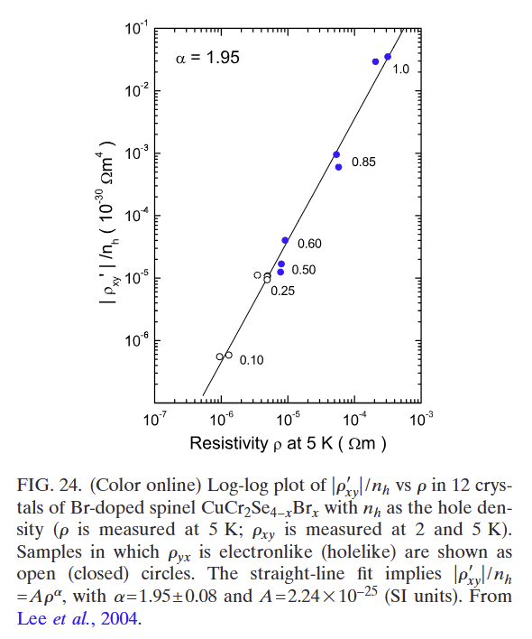
Experimental Evidence
Material | O_{xy} (S/cm) | Mechanism | Notes
Fe (bcc) | ~750 | Intrinsic | Transition metal benchmark, Berry curvature maps well with ab initio
Co (hcp) | ~480 | Intrinsic | Good agreement with first-principles Berry curvature calc.
Ni (fcc) | ~200 | Intrinsic/Skew | Mixed mechanism, skew scattering non-negligible
CuCr₂Se₄ | ~3200 | Intrinsic | Spinel; confirmed p_{xy} = p² scaling (Lee et al. 2004)
Co₃Sn₂S₂ | ~1130 | Intrinsic | Magnetic Weyl semimetal; Fermi arc surface states
Mn_{x}Ga_{1-x}As | Varies | Intrinsic/Skew | Dilute magnetic semiconductor; gate-tunable AHE
Reference: Nagaosa et al. RMP 2010; Lee et al. PRL 2004; Liu et al. Nano Lett. 2020

Slide 6
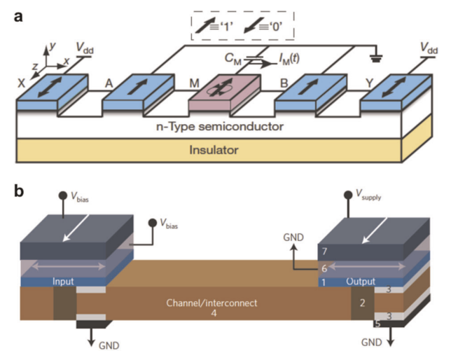
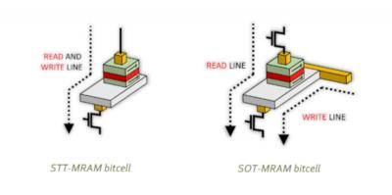
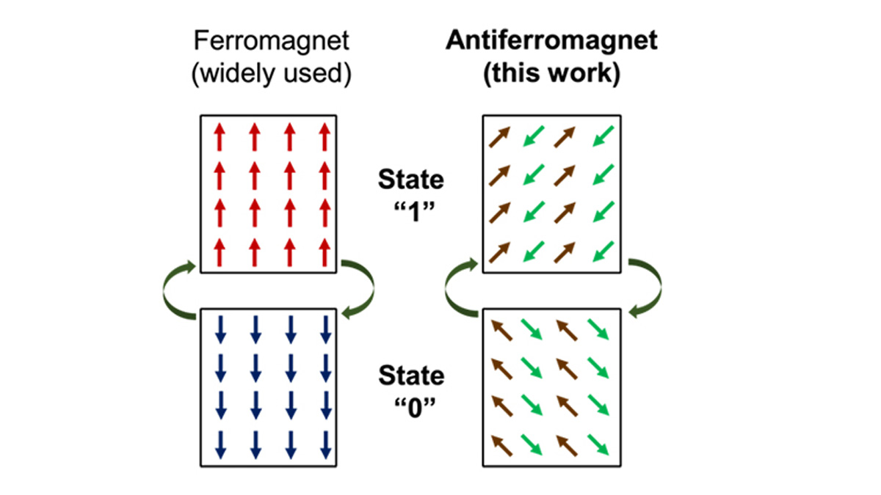
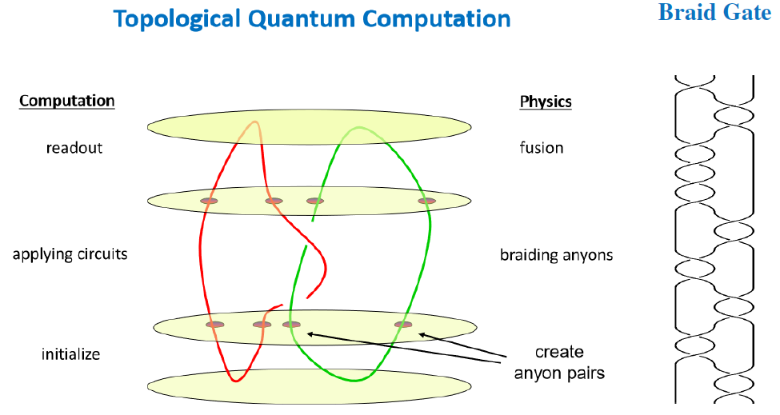
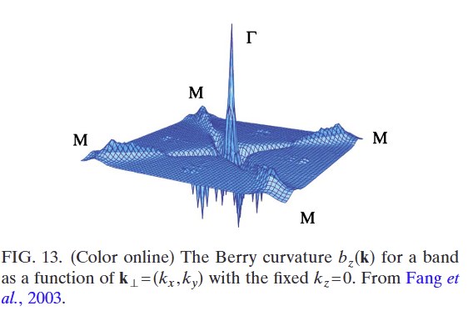
Applications
Spintronics Devices
AHE enables reading magnetic state without external B field. Used in magnetic sensors and read heads
MRAM (Spin-orbit Torque)
Spin Hall + AHE detect and switch magnetization. SOT-MRAM is faster and more efficient than STT-MRAM
Topological Material Probe
AHE is strong for ferromagnetism and Weyl fermions. Used to detect topological phase transitons
Quantum Anomalous Hall (QAHE)
Quantized AHE at zero B – observed in Cr-doped (BiSb)₂Te_{3.,} platform for dissipation less edge transport
Antiferromagnetic Spintronics
AHE in noncollinear AFMs (Mn₃Sn) opens ultrafast Thz spintronic devices without stray fields
Topological Computing
Berry curvature engineering in 2D magnets (Crl₃, Fe₃GeTe₂) for future topological quantum computing

